Slide 1
UK Biobank: Rheumatoid Arthritis Positive Control

Slide 2
HYDRA Clustering

Slide 3
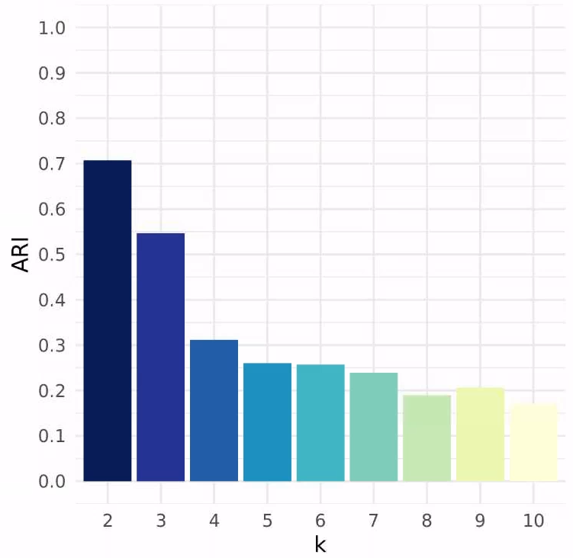
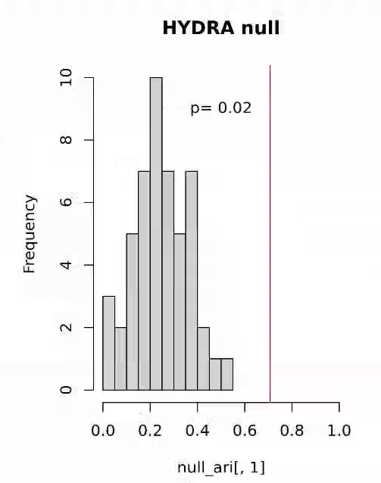
HYDRA clustering: RA
HYDRA results from 'Real' data (RA vs Controls) vs NULL data (Simulated Data vs Controls)
50 simulated random datasets; 3x CV
each simulation has same mean and variance as Real MDD cases
same controls used for Real vs NULL data
Real ARI significantly different from NULL distribution
Code adapted from: https://pubmed.ncbi.nlm.nih.gov/30935858/
k tested for 2-10
Unsupervised (using all proteins)
139 RA vs 139 controls
Covariate adjustments:
age_lp + sex_lp + age2_lp + pop + Batch + ukb_centre_fct_lp + tbms_lp + blood_season_fct_lp + fasting_time_lp
k=2 or k=3 are strong choices HYDRA (barplot)
Assuming this RA cohort is positive control, proceed with strongest evidence line, i.e., k=2
NULL distribution confirms k=2 (far right)

Slide 4
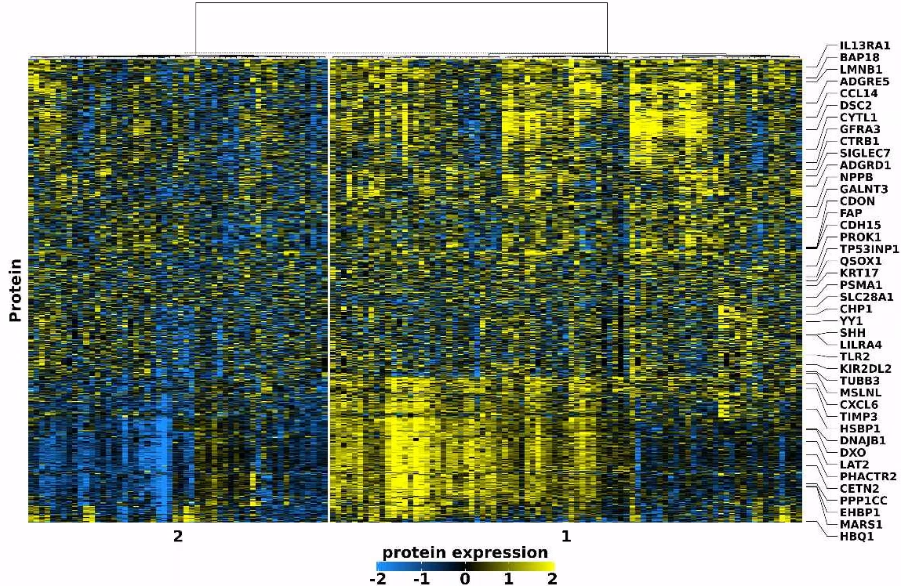
HYDRA clustering: RA
C1 appears characterized by high expression of Group A & B proteins
C2 characterized by low expression of Group B proteins
C1 dominated by elevated expr. of very well characterized RA biomarkers:
TNF, TNFRSF1B, LGALS9, CD83, HAVCR2 (TIM3), PLAUR, CD300E, et cetera
C2 lacks expression of C1 RA biomarkers, and is a low-BMP6+PEAR1+TIA1+CD244 subtype
C1 Top 20 Most Expressed |  |  | C2 Bottom 20 Least Expressed
Protein | C1 Mean |  | Protein | C2 Mean
TNF | 1.37 |  | STAT5B | -0.74
TNFRSF1B | 1.37 |  | RNF5 | -0.74
TNF | 1.36 |  | FLI1 | -0.74
LGALS9 | 1.35 |  | BIRC2 | -0.75
TNF | 1.33 |  | CD244 | -0.75
TNF | 1.33 |  | NAGK | -0.76
CD83 | 1.29 |  | CASP7 | -0.76
HAVCR2 | 1.29 |  | HCLS1 | -0.76
PLAUR | 1.27 |  | ARHGEF1 | -0.76
CD300E | 1.27 |  | EVI5 | -0.77
TNFRSF14 | 1.22 |  | RRAS | -0.77
PSAP | 1.21 |  | DAG1 | -0.77
CD74 | 1.20 |  | SH2B3 | -0.77
TNFRSF4 | 1.19 |  | ECHS1 | -0.78
CCL7 | 1.19 |  | MPHOSPH8 | -0.78
PDCD1 | 1.18 |  | RRM2B | -0.78
TNFRSF10A | 1.17 |  | TOP2B | -0.79
IL18BP | 1.16 |  | TIA1 | -0.79
IFI30 | 1.15 |  | PEAR1 | -0.81
TNFRSF11A | 1.15 |  | BMP6 | -0.83
Group A
Group B

Slide 5
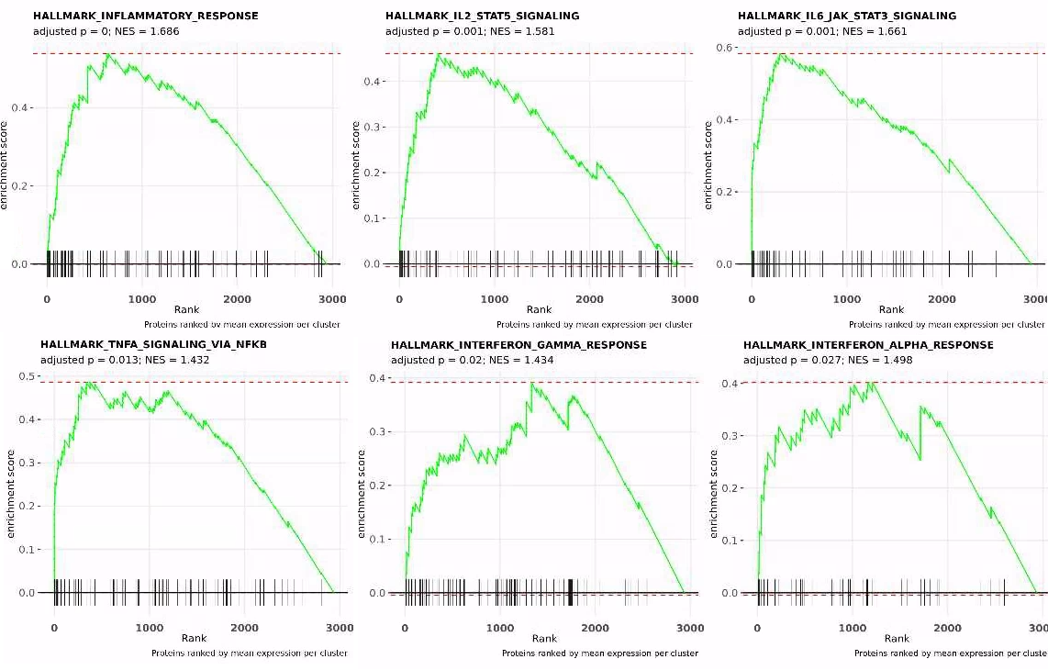
HYDRA clustering: RA
C1 is definitively the Inflammatory Rheumatoid Arthritis subtype, with well-known up-regulated implicated pathways:
IL2, IL6, TNF, INF-α, INF-γ
C2, lacking these activated pathways, has implications for standard treatment response for C2 patients
C1 Top 20 Most Expressed |  |  | C2 Bottom 20 Least Expressed
Protein | C1 Mean |  | Protein | C2 Mean
TNF | 1.37 |  | STAT5B | -0.74
TNFRSF1B | 1.37 |  | RNF5 | -0.74
TNF | 1.36 |  | FLI1 | -0.74
LGALS9 | 1.35 |  | BIRC2 | -0.75
TNF | 1.33 |  | CD244 | -0.75
TNF | 1.33 |  | NAGK | -0.76
CD83 | 1.29 |  | CASP7 | -0.76
HAVCR2 | 1.29 |  | HCLS1 | -0.76
PLAUR | 1.27 |  | ARHGEF1 | -0.76
CD300E | 1.27 |  | EVI5 | -0.77
TNFRSF14 | 1.22 |  | RRAS | -0.77
PSAP | 1.21 |  | DAG1 | -0.77
CD74 | 1.20 |  | SH2B3 | -0.77
TNFRSF4 | 1.19 |  | ECHS1 | -0.78
CCL7 | 1.19 |  | MPHOSPH8 | -0.78
PDCD1 | 1.18 |  | RRM2B | -0.78
TNFRSF10A | 1.17 |  | TOP2B | -0.79
IL18BP | 1.16 |  | TIA1 | -0.79
IFI30 | 1.15 |  | PEAR1 | -0.81
TNFRSF11A | 1.15 |  | BMP6 | -0.83

Slide 6
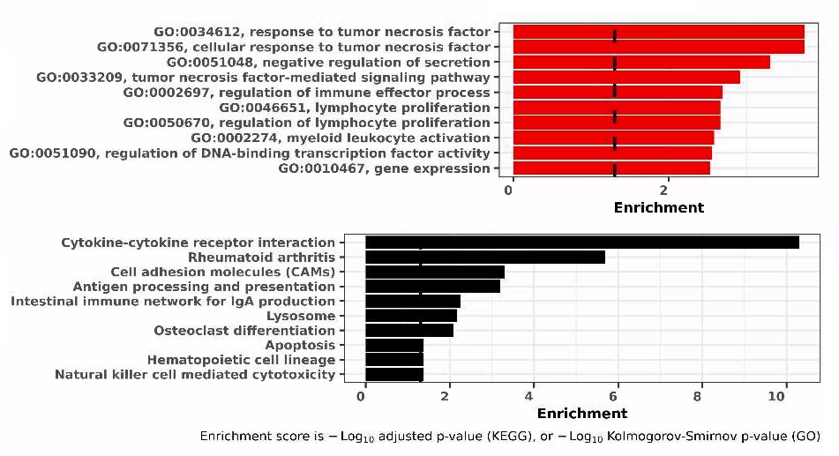
HYDRA clustering: RA
C1 enrichments based on top 100 highest/lowest expressed proteins (absolute values)
GO BP (red)
KEGG (black)
TNF signaling, lymphocyte proliferation, Myeloid activation dominate top terms
Overall interpretation:
C1 is inflammatory RA subtype, with high TNF and represents known Lymphoid and Myeloid molecular subtypes
C2 lacks immune signaling and may represent known Pauci Immune subtype

Slide 7
UK Biobank: BP; SCZ

Slide 8
HYDRA Clustering

Slide 9
BP (Bipolar)

Slide 10
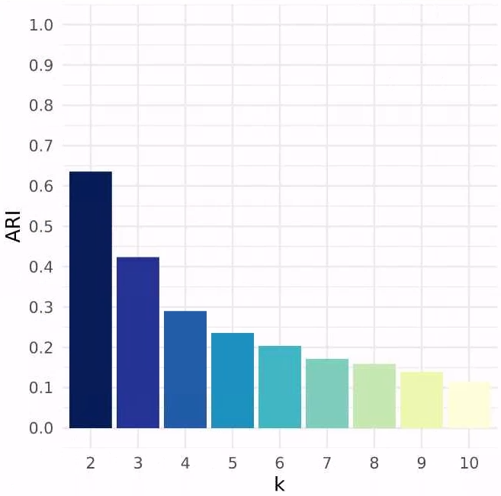
HYDRA clustering: BP
k tested for 2-10
Unsupervised (using all proteins)
205 BP vs 3x controls (615)
Covariate adjustments:
age_lp + sex_lp + age2_lp + pop + Batch + ukb_centre_fct_lp + tbms_lp + blood_season_fct_lp + fasting_time_lp
HYDRA suggests k=2 or k=3 (barplot)

Slide 11
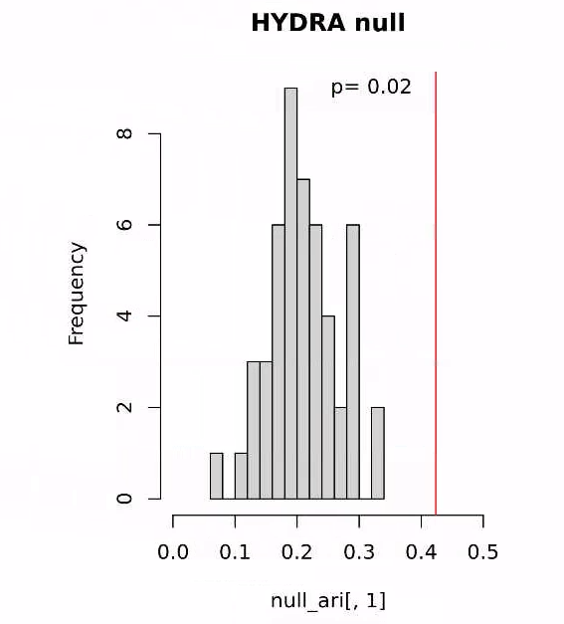
HYDRA NULL distribution: BP
HYDRA results from 'Real' data (BP vs Controls) vs NULL data (Simulated Data vs Controls)
50 simulated random datasets; 3x CV
each simulation has same mean and variance as Real BP cases
same controls used for Real vs NULL data
Real ARI significantly different from NULL distribution
Adds weight that k=3 is ideal cluster solution
Real Data
ARI
0.42
Simulated Data
ARIs compared and p-values derived
ARI
0.24
0.20
0.14
0.29
0.14
*50 simulations

Slide 12
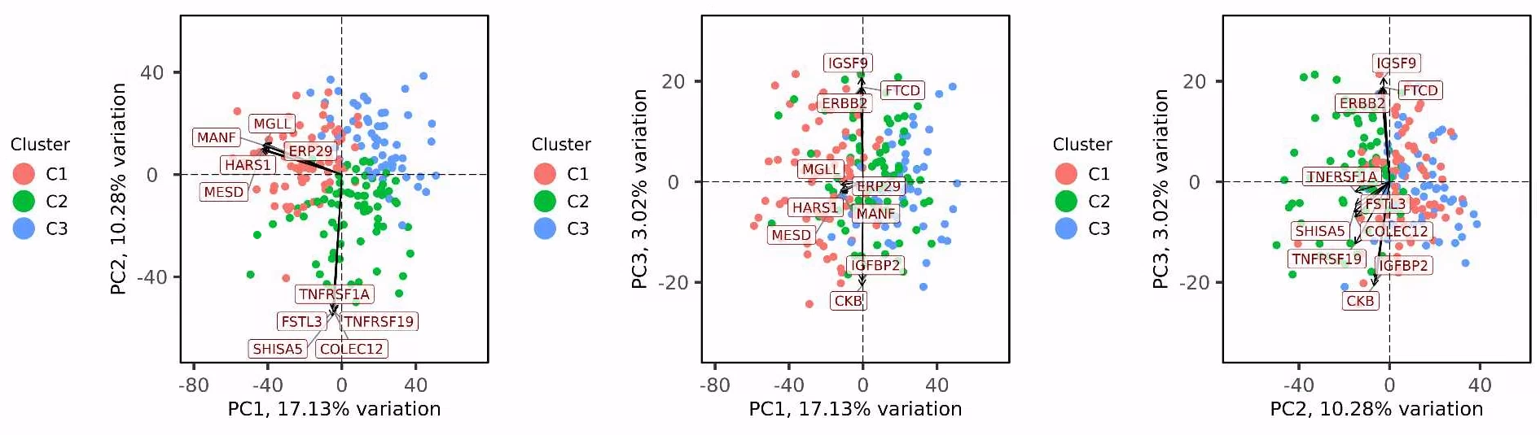
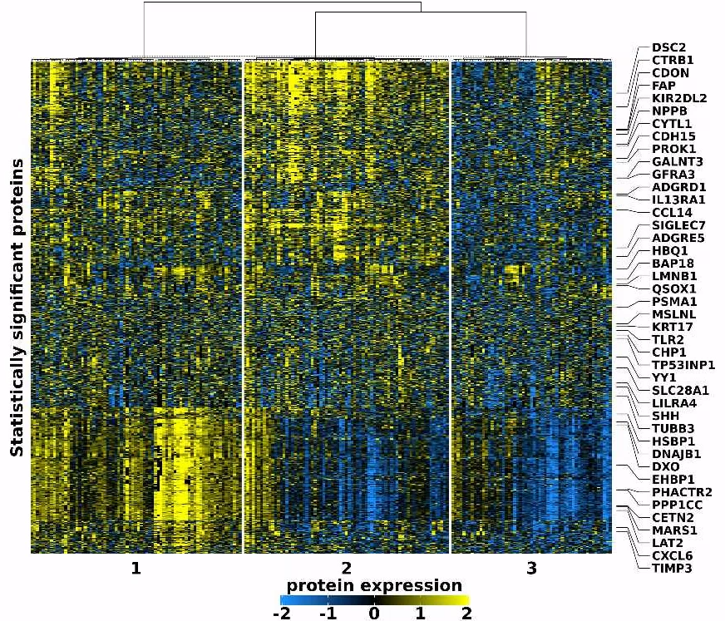
Cluster heatmap: BP
HYDRA cluster solution
BP cases only
C1 - C3 segregated
Expression:
Gold/Yellow, high relative expression
Blue, low relative expression

Slide 13
Cluster Associations: BP
Top (left) & Bottom (right) 20 proteins expressed per cluster
Top 20
Bottom 20
Protein | C1 Mean | Protein | C2 Mean | Protein | C3 Mean
MANF | 1.06 | EFNA4 | 1.61 | IL15 | 0.46
MESD | 1.05 | NECTIN4 | 1.58 | CES2 | 0.42
ENO2 | 1.04 | TGFBR2 | 1.57 | FRMD7 | 0.37
HARS1 | 1.03 | BTN2A1 | 1.55 | CEACAM5 | 0.36
PPIB | 1.02 | TNFRSF1A | 1.53 | APLP1 | 0.36
EIF4G1 | 1.02 | FSTL3 | 1.50 | TTR | 0.35
TBCB | 1.02 | TNFRSF1B | 1.49 | AMPD3 | 0.33
SKAP2 | 1.01 | LTBR | 1.48 | AHSP | 0.32
SERPINB6 | 1.01 | EFNA1 | 1.48 | HBQ1 | 0.32
TRIAP1 | 1.01 | SHISA5 | 1.47 | HMBS | 0.31
CASP2 | 1.01 | EPHB4 | 1.47 | ARG1 | 0.31
DNAJB6 | 1.00 | TNFRSF4 | 1.46 | CALCA | 0.29
CD69 | 1.00 | COLEC12 | 1.45 | TGM2 | 0.27
SERPINB1 | 1.00 | CSF1 | 1.45 | ASAH2 | 0.27
CACNB3 | 1.00 | TNFRSF19 | 1.44 | MYL4 | 0.27
TBC1D23 | 1.00 | CLMP | 1.44 | IL10 | 0.27
ERP29 | 1.00 | PIK3IP1 | 1.43 | PRDX2 | 0.27
GP6 | 1.00 | NPC2 | 1.43 | LRRC38 | 0.26
CRKL | 1.00 | THY1 | 1.43 | PRAP1 | 0.26
DOK2 | 1.00 | COL6A3 | 1.42 | FGF21 | 0.25
Protein | C1 Mean | Protein | C2 Mean | Protein | C3 Mean
KLRC1 | -0.34 | GTPBP2 | -0.43 | IDO1 | -0.72
ADGRG2 | -0.34 | SMPDL3A | -0.44 | CERT | -0.72
DLGAP5 | -0.34 | IL7 | -0.44 | PECAM1 | -0.72
KLK1 | -0.35 | CRYBB2 | -0.44 | ARSB | -0.74
LIFR | -0.35 | SRC | -0.45 | ITGB2 | -0.74
CRYBB2 | -0.36 | NT5C3A | -0.45 | CXCL3 | -0.74
IL7R | -0.36 | APOA1 | -0.46 | HMOX2 | -0.74
CRTAC1 | -0.37 | ITGA6 | -0.47 | NRP2 | -0.75
HPGDS | -0.37 | PON1 | -0.47 | TYMP | -0.75
EFHD1 | -0.37 | PEPD | -0.48 | TNFRSF17 | -0.75
APLP1 | -0.37 | APOM | -0.50 | WARS | -0.76
LPL | -0.38 | ERBB4 | -0.51 | ECHS1 | -0.76
LRRN1 | -0.38 | ITGAV | -0.54 | PPP3R1 | -0.77
MXRA8 | -0.40 | ITGB5 | -0.63 | IDO1 | -0.77
DCN | -0.42 | NPHS1 | -0.64 | WIF1 | -0.78
ITGA11 | -0.44 | GNPDA2 | -0.66 | SOD2 | -0.78
GH1 | -0.45 | RAB6A | -0.69 | GSR | -0.80
ITGAV | -0.67 | NELL1 | -0.73 | CXCL11 | -0.81
ITGAM | -0.70 | CTSV | -0.80 | ITGB5 | -0.81
ITGB2 | -0.73 | UMOD | -0.81 | GNPDA2 | -0.82

Slide 14
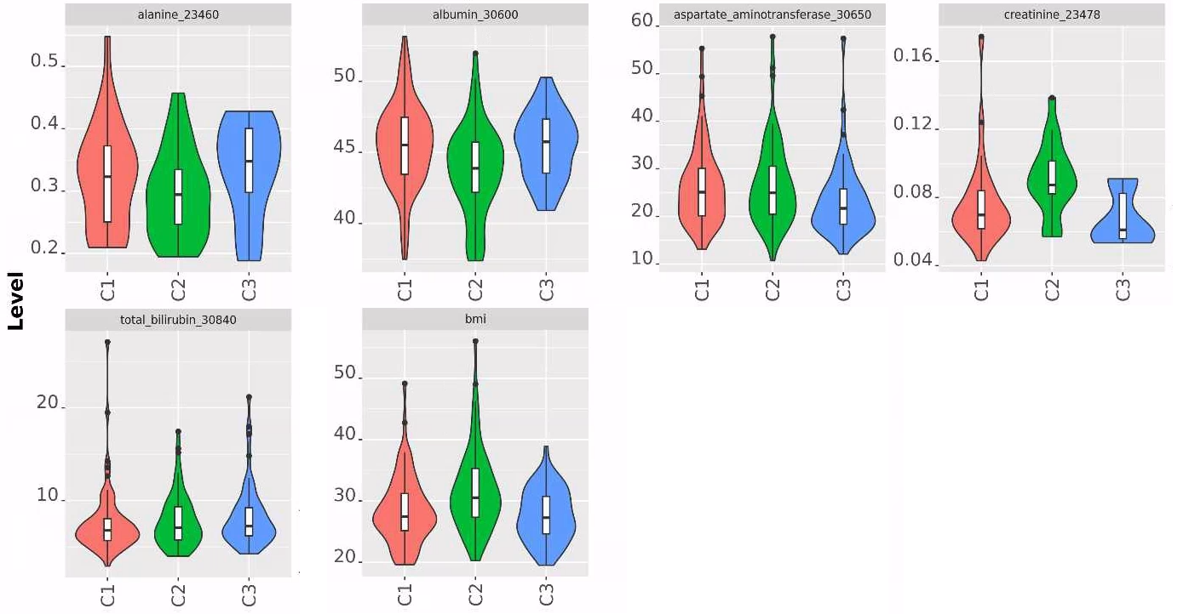
Cluster Associations: BP
BMI & blood-based biomarkers
Albumin, Aspartate, Creatine, BMI each p<0.05

Slide 15
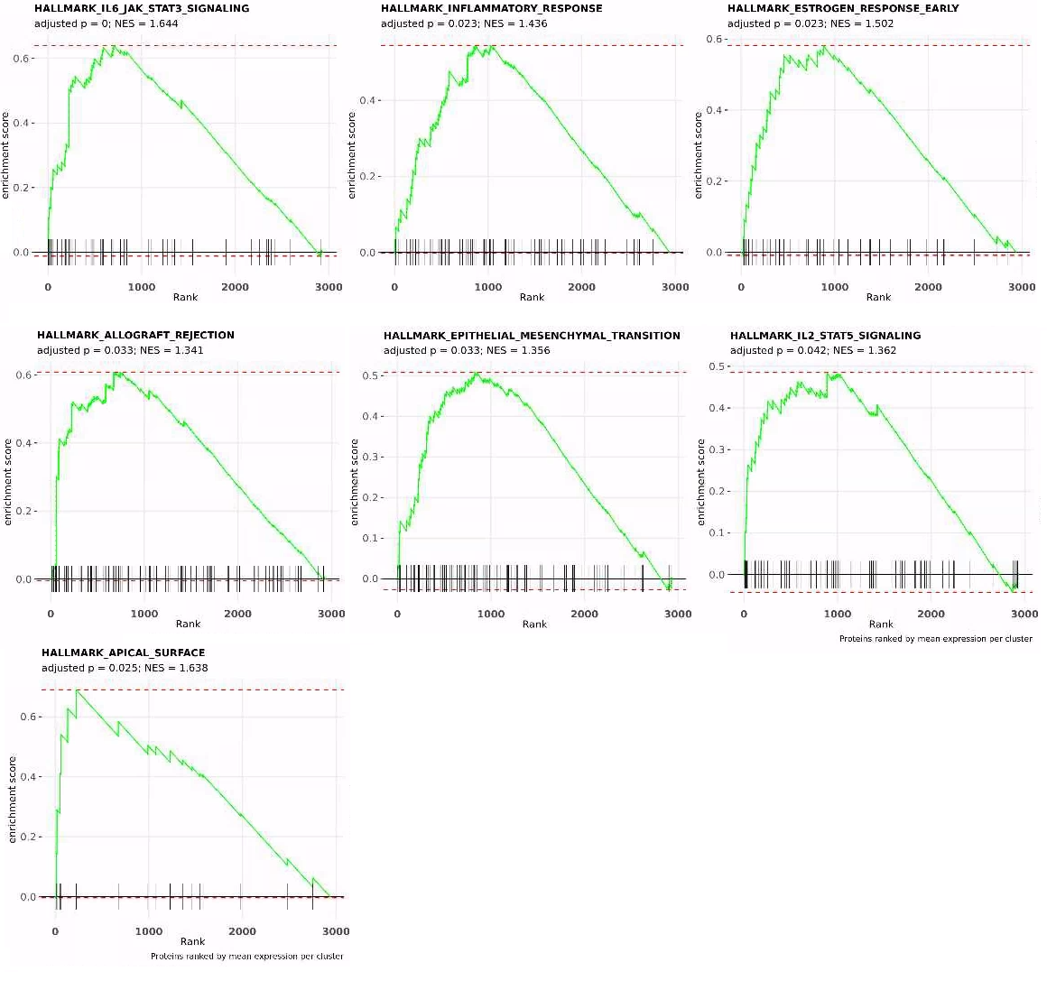
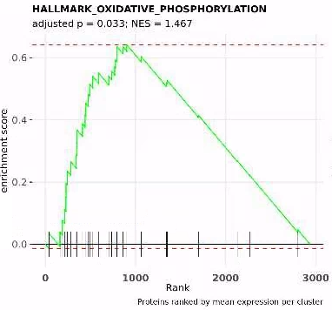
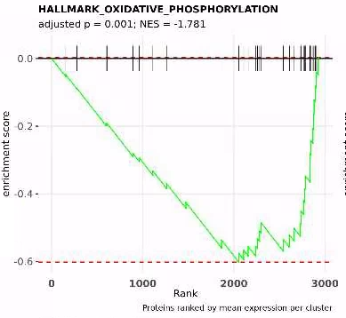
Cluster Associations: BP
C2
C1
C1 (top) and C3 (bottom) are the reverse of each other.
C3
C2 has more enrichments for immune-related pathways / signatures

Slide 16
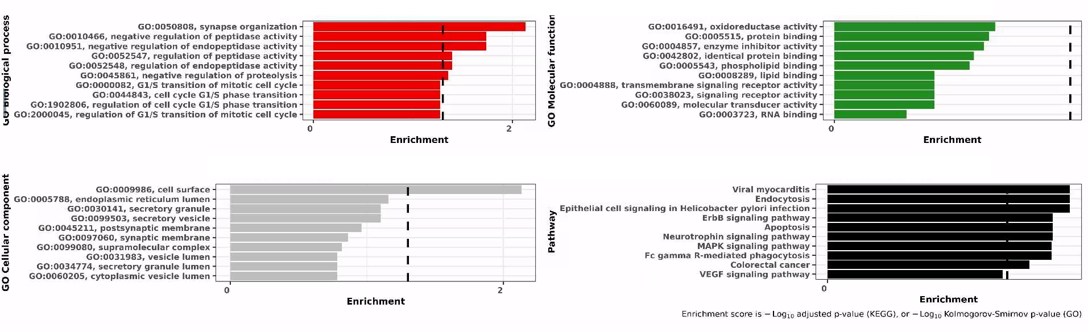
Cluster Associations: BP
C1 GO and KEGG enrichments
synapse organization (GO BP); peptidase activity (GO BP) - one study highlighted link between plasma peptidase and lithium-treated BP (https://pubmed.ncbi.nlm.nih.gov/15005755/)
Neurotrophin signaling pathway (KEGG)- known link with BP exists (https://pubmed.ncbi.nlm.nih.gov/25193130/)

Slide 17
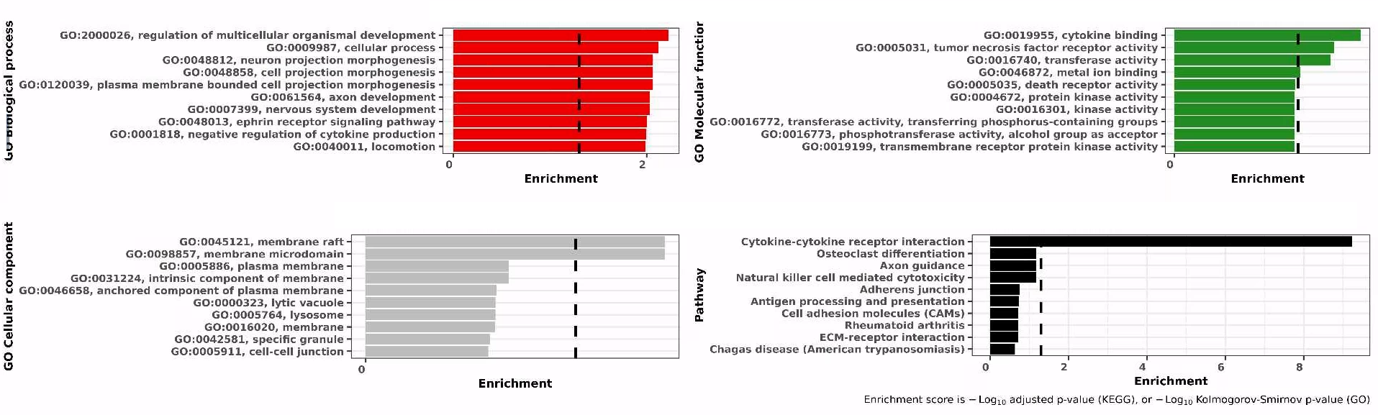
Cluster Associations: BP
C2 GO and KEGG enrichments
Cytokine binding (GO MF)
Cytokine-cytokine receptor interaction (KEGG)
TNF receptor activity (GO MF)

Slide 18
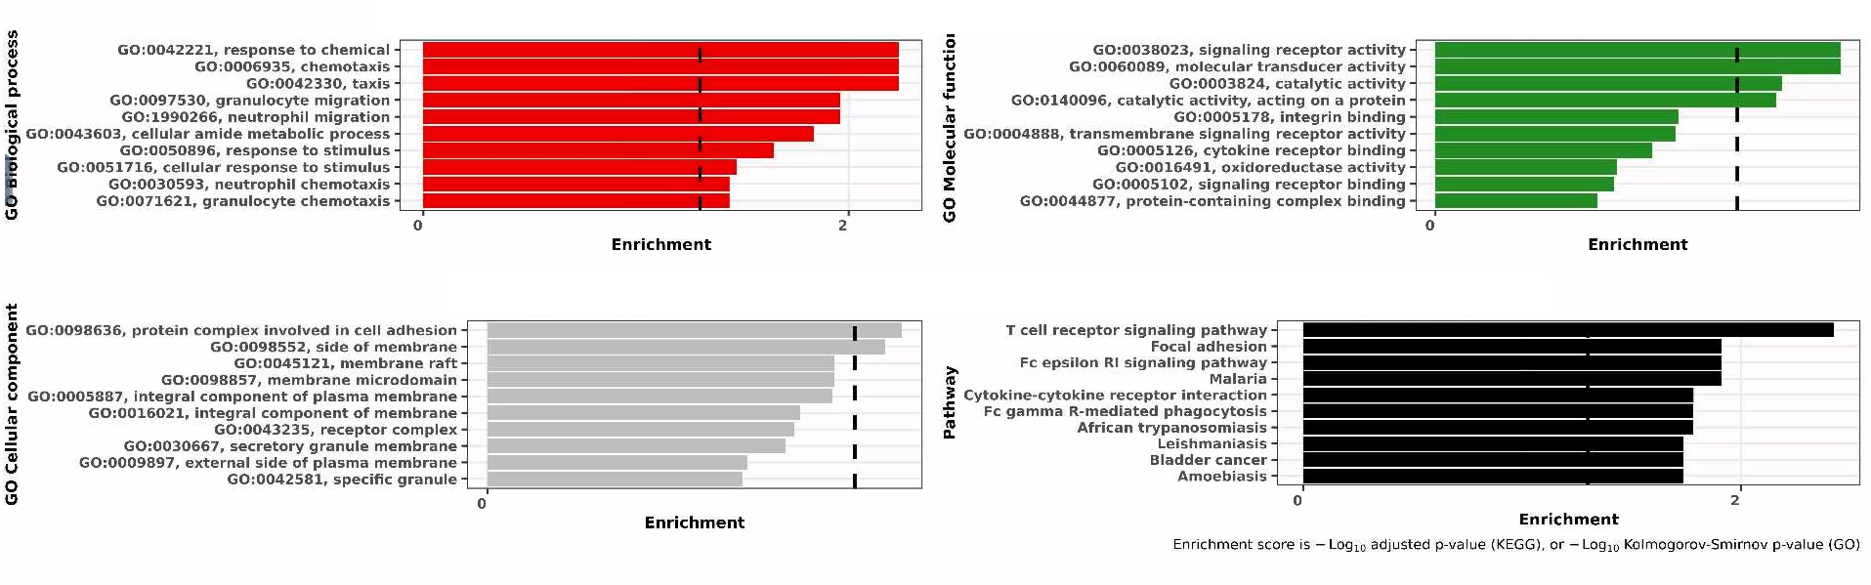
Cluster Associations: BP
C3 GO and KEGG enrichments
T cell receptor signaling pathway (KEGG)
Cytokine-cytokine receptor interaction (KEGG)
neutrophil migration (GO BP) - linked previously to BP
Based on GSEA results, implication that these are all DOWN-regulated signatures

Slide 19
SCZ (Schizophrenia)

Slide 20
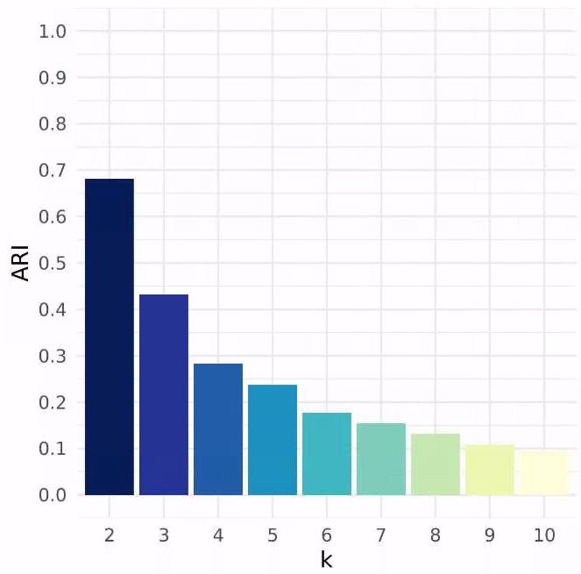
HYDRA clustering: SCZ
k tested for 2-10
Unsupervised (using all proteins)
207 SCZ vs 3x controls (621)
Covariate adjustments:
age_lp + sex_lp + age2_lp + pop + Batch + ukb_centre_fct_lp + tbms_lp + blood_season_fct_lp + fasting_time_lp
HYDRA suggests k=2 or k=3 (barplot)

Slide 21
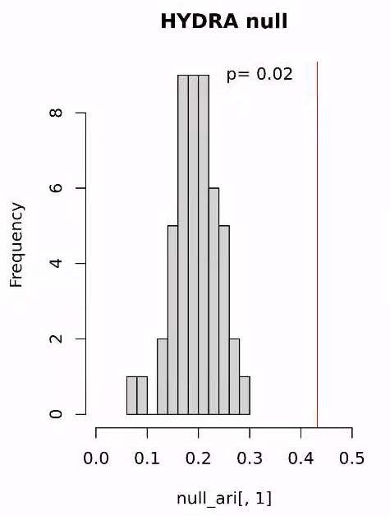
HYDRA NULL distribution: SCZ
HYDRA results from 'Real' data (SCZ vs Controls) vs NULL data (Simulated Data vs Controls)
50 simulated random datasets; 3x CV
each simulation has same mean and variance as Real SCZ cases
same controls used for Real vs NULL data
Real ARI significantly different from NULL distribution
Adds weight that k=3 is ideal cluster solution
Code adapted from: https://pubmed.ncbi.nlm.nih.gov/30935858/
Real Data
ARI
0.43
Simulated Data
ARIs compared and p-values derived
ARI
0.18
0.29
0.26
0.26
0.18
*50 simulations

Slide 22
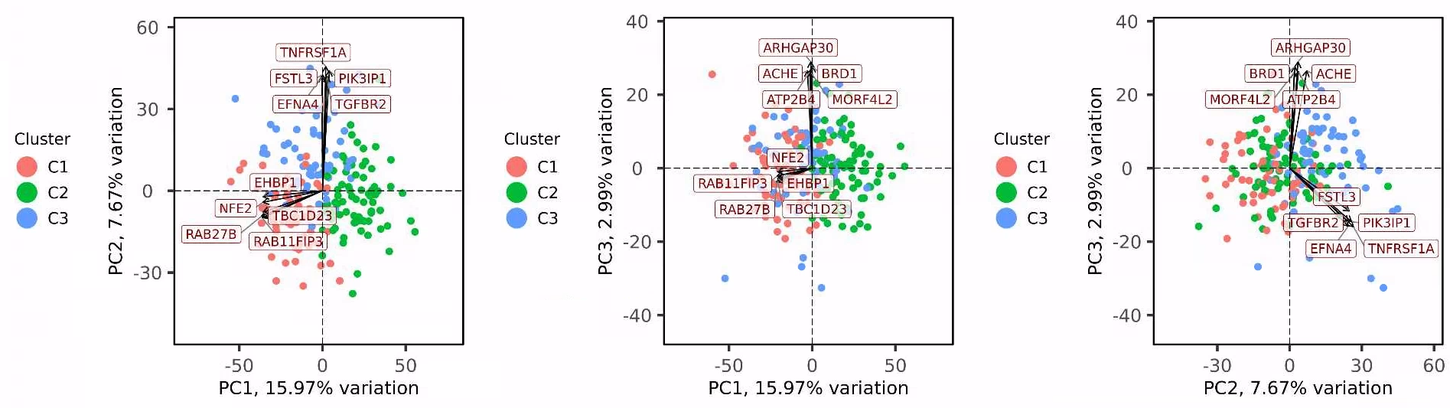
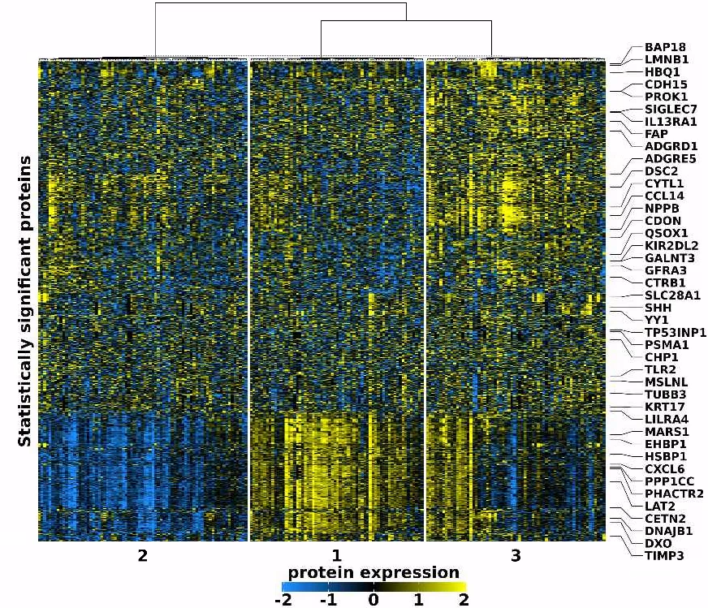
Cluster heatmap: SCZ
HYDRA cluster solution
SCZ cases only
C1 - C3 segregated
Expression:
Gold/Yellow, high relative expression
Blue, low relative expression
https://ranchobiosciences.sharepoint.com/:p:/s/Janssen_Mood_Disorder/ETq8X0K1Wj5Ai-AeSYOsYDIBGpBKbPX9FOe8LES17XUnqQ?e=aOnNFA
https://ranchobiosciences.sharepoint.com/:p:/s/Janssen_Mood_Disorder/ETq8X0K1Wj5Ai-AeSYOsYDIBGpBKbPX9FOe8LES17XUnqQ?e=aOnNFA

Slide 23
Cluster Associations: SCZ
Top (left) & Bottom (right) 20 proteins expressed per cluster
Top 20
Bottom 20
Protein | C1 Mean | Protein | C2 Mean | Protein | C3 Mean
RAB27B | 1.01 | CEACAM5 | 0.68 | AGRN | 1.12
CMC1 | 0.97 | WFDC2 | 0.66 | NPC2 | 1.12
ESYT2 | 0.97 | PIGR | 0.61 | GFRA1 | 1.12
MECR | 0.95 | PRL | 0.60 | EFNA4 | 1.11
PRKG1 | 0.94 | LAMP3 | 0.59 | TNFRSF1A | 1.10
GCC1 | 0.94 | CXCL17 | 0.58 | COL6A3 | 1.09
DUT | 0.93 | BPIFB1 | 0.57 | CST3 | 1.08
RAB11FIP3 | 0.93 | MSLN | 0.56 | CRHBP | 1.06
FKBP14 | 0.93 | CA4 | 0.55 | PRAP1 | 1.05
CLIP2 | 0.93 | GDF15 | 0.53 | IGFBP4 | 1.05
MANF | 0.92 | TNFRSF10B | 0.50 | CCL16 | 1.03
PDIA4 | 0.92 | CEACAM6 | 0.49 | FGFR2 | 1.02
HPCAL1 | 0.92 | EPHB4 | 0.48 | ASGR1 | 1.02
EEF1D | 0.91 | MANSC1 | 0.47 | SHISA5 | 1.01
EIF4G1 | 0.91 | BGN | 0.47 | THY1 | 1.01
SLMAP | 0.91 | ALPP | 0.46 | OCLN | 1.01
TJAP1 | 0.90 | CCER2 | 0.45 | COL15A1 | 0.99
AP3B1 | 0.90 | ACVRL1 | 0.45 | RNASE1 | 0.99
DNAJA2 | 0.90 | DLL1 | 0.45 | RBP5 | 0.99
PPIB | 0.90 | CLEC7A | 0.43 | SERPINF1 | 0.98
Protein | C1 Mean | Protein | C2 Mean | Protein | C3 Mean
KLRD1 | -0.52 | TACC3 | -0.92 | KITLG | -0.40
EPHA4 | -0.53 | PLA2G4A | -0.93 | ITGA2 | -0.41
FLT3 | -0.53 | MITD1 | -0.93 | ESM1 | -0.42
ADGRG2 | -0.54 | CMIP | -0.93 | HPGDS | -0.44
IL32 | -0.54 | CA13 | -0.93 | SHBG | -0.46
ITGA11 | -0.55 | TBL1X | -0.93 | GP2 | -0.46
DCN | -0.55 | PDAP1 | -0.94 | GH1 | -0.49
NCR1 | -0.55 | NT5C3A | -0.94 | IGFBP1 | -0.50
IL17D | -0.55 | HARS1 | -0.94 | ADGRG2 | -0.51
MXRA8 | -0.56 | UFD1 | -0.95 | UMOD | -0.52
PLTP | -0.57 | IRAK4 | -0.95 | LPL | -0.52
FCRL6 | -0.57 | PPP3R1 | -0.95 | LEPR | -0.53
CD160 | -0.58 | NUB1 | -0.95 | MENT | -0.62
EFHD1 | -0.58 | SUGT1 | -0.96 | APOA1 | -0.64
HPGDS | -0.59 | ITGB5 | -0.96 | ADIPOQ | -0.65
XG | -0.59 | IL7 | -0.97 | MXRA8 | -0.65
VGF | -0.63 | NAGK | -0.97 | PON3 | -0.65
ITGAV | -0.74 | SLA2 | -0.97 | ITGA11 | -0.73
ITGB2 | -0.77 | SNAPIN | -0.97 | APOF | -0.76
ITGAM | -0.79 | GNPDA2 | -1.04 | ITGAV | -0.79

Slide 24
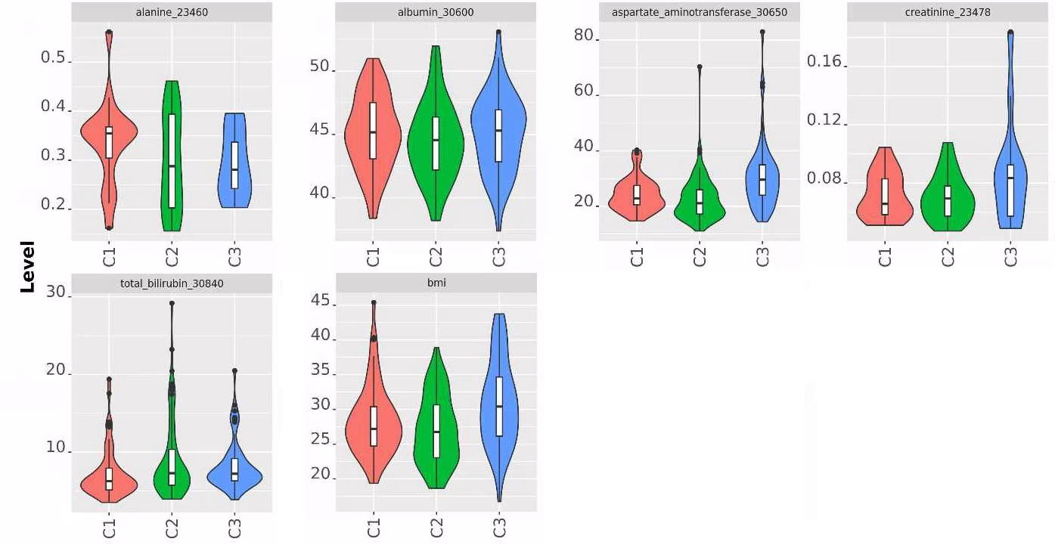
Cluster Associations: SCZ
BMI & blood-based biomarkers
Aspartate, Bilirubin, BMI each p<0.05

Slide 25
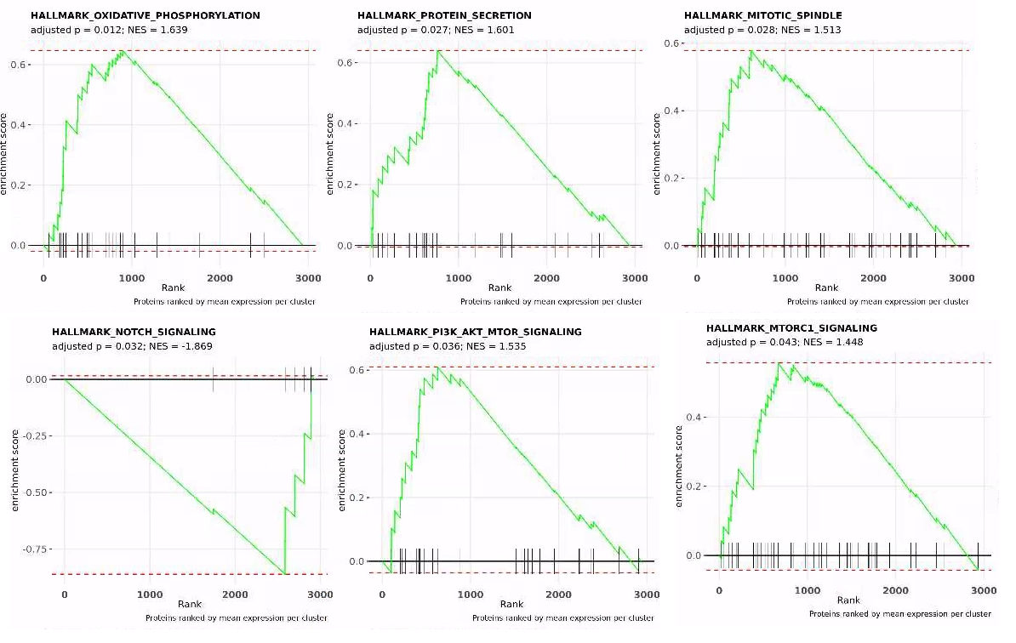
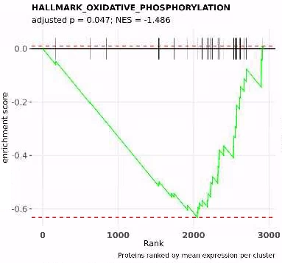
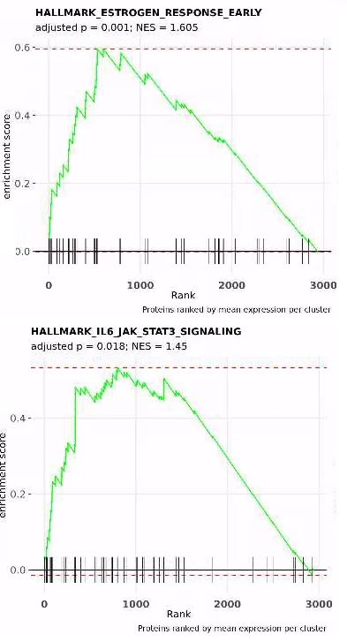
Cluster Associations: SCZ
C2
C3
C1
Statistically significant mSigDB Hallmark signatures
Much literature on Notch signaling in Schizophrenia (C1), oxidative phosphorylation (C1 + C2), plus estrogen signaling (C3)

Slide 26
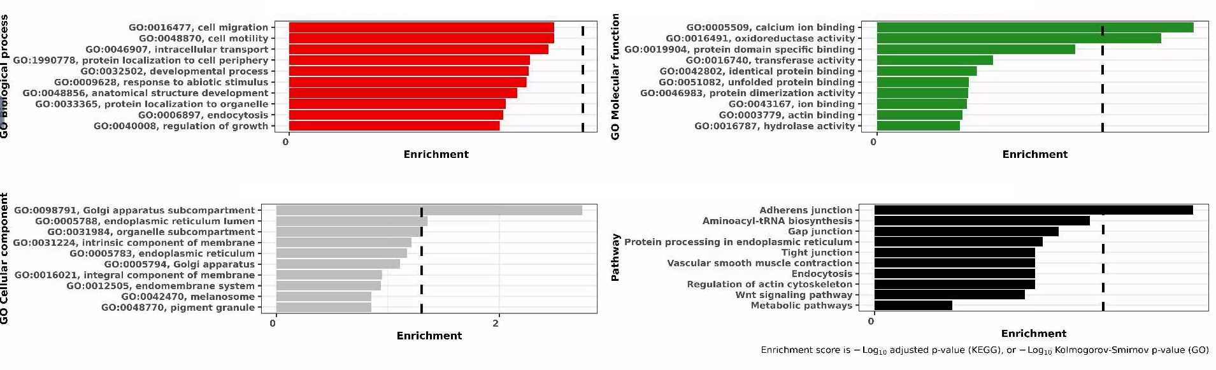
Cluster Associations: SCZ
C1 GO and KEGG enrichments
Role of Adherens junction (KEGG) in Schizophrenia is known

Slide 27
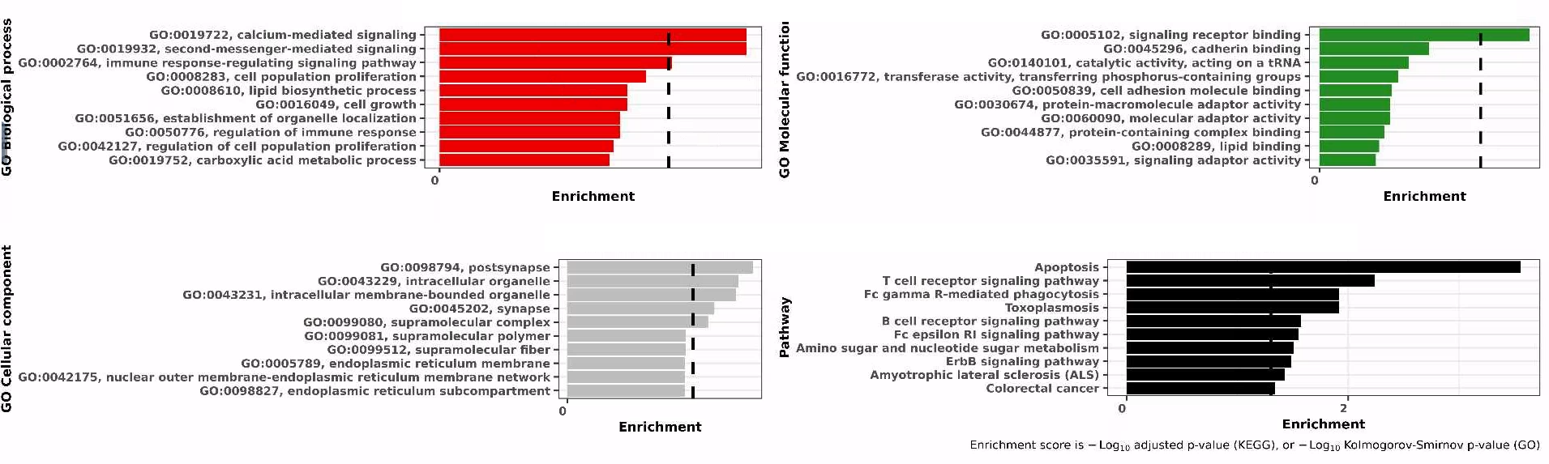
Cluster Associations: SCZ
C2 GO and KEGG enrichments
Indicates altered immune and Apoptosis (KEGG) activity
Strong link in literature between dysregulated apoptosis and SCZ
Implication from GSEA is down-regulation of these signatures

Slide 28
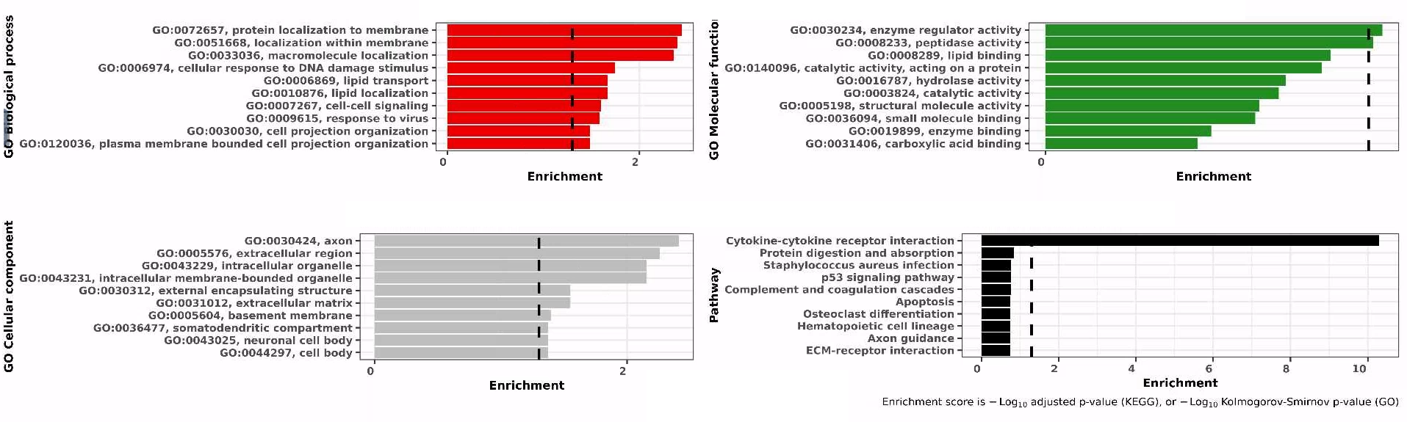
Cluster Associations: SCZ
C3 GO and KEGG enrichments
Strong association with Cytokine-cytokine receptor interaction (KEGG)
The 'immune' subtype

Slide 29
Protein Regulatory Network (PRN)

Slide 30
Protein Regulatory Network (PRN)
Protein Co-Expression network (Pearson correlation)
Correlation matrix generated per subtype (C1, C2, C3), then converted to graph object
Vertices == Proteins
Edges == Correlation co-efficient between pairwise proteins
Filtering:
Edges removed if Pearson < 0.8
Vertices (proteins) removed if no correlation with any other
Filtered graph converted to Minimum Spanning Tree (MST)
Protein Communities (Modules) identified
a group of proteins with similar network topology / highly co-correlated
Key proteins identified via
vertex degree (number of edges per protein)
hub scores (https://igraph.org/r/doc/hub_score.html)
authority scores (https://igraph.org/r/doc/authority_score.html)
Reference: https://www.biostars.org/p/285296/ (my own tutorial)

Slide 31
Protein Regulatory Network (PRN)
A network-based approach can extrapolate info from 'structures' in data
Contrast to holistic approaches that look at expression across entire subtype
Biological assumption would be that, per sub-type, there are diverse biological underpinnings that cannot be easily identified holistically.

Slide 32
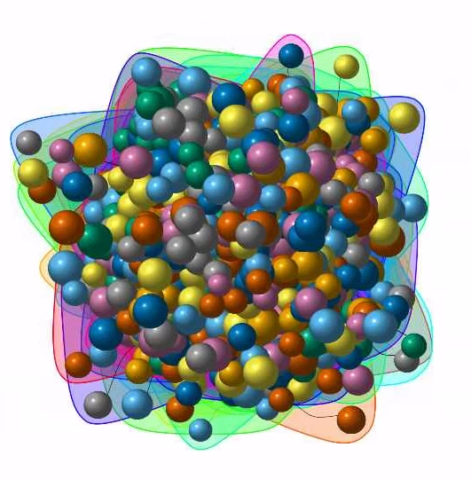
Protein Regulatory Network: BP
'Key proteins' defined by:​
vertex degree > 5​
hub score > 0.8​
authority scores > 0.8
KEGG enrichment on key proteins (top 10 pathways at p<0.05)
Dysregulation of Th17 (C2) and Th1 / Th2 (C3) T-cells has been well cited in bipolar research
JAK-STAT strongly implicated for C3, not C2
C1 cell-adhesion association is well-addressed in literature, including in relation to Lithium response
C1 | C2 | C3
HSA04640 HEMATOPOIETIC CELL LINEAGE | HSA04640 HEMATOPOIETIC CELL LINEAGE | TH1 AND TH2 CELL DIFFERENTIATION
HEMATOPOIETIC CELL LINEAGE | HEMATOPOIETIC CELL LINEAGE | CYTOKINE-CYTOKINE RECEPTOR INTERACTION
HEMATOPOIETIC CELL LINEAGE HOMO SAPIENS HSA04640 | HEMATOPOIETIC CELL LINEAGE HOMO SAPIENS HSA04640 | JAK STAT SIGNALING PATHWAY
CELL ADHESION MOLECULES | TH17 CELL DIFFERENTIATION | HSA04630 JAK STAT SIGNALING PATHWAY
HSA04514 CELL ADHESION MOLECULES | CHAGAS DISEASE | JAK-STAT SIGNALING PATHWAY HOMO SAPIENS HSA04630
CELL ADHESION MOLECULES (CAMS) HOMO SAPIENS HSA04514 | CHAGAS DISEASE (AMERICAN TRYPANOSOMIASIS) | JAK-STAT SIGNALING PATHWAY
CELL ADHESION MOLECULES (CAMS) | CHAGAS DISEASE (AMERICAN TRYPANOSOMIASIS) HOMO SAPIENS HSA05142 | INFLAMMATORY BOWEL DISEASE (IBD)
GRAFT-VERSUS-HOST DISEASE HOMO SAPIENS HSA05332 | LYSOSOME HOMO SAPIENS HSA04142 | INFLAMMATORY BOWEL DISEASE (IBD) HOMO SAPIENS HSA05321
GRAFT-VERSUS-HOST DISEASE | LYSOSOME | INFLAMMATORY BOWEL DISEASE
INTESTINAL IMMUNE NETWORK FOR IGA PRODUCTION HOMO SAPIENS HSA04672 | MEASLES HOMO SAPIENS HSA05162 | CYTOKINE CYTOKINE RECEPTOR INTERACTION
Results are in line with earlier GO and KEGG enrichments, but add more granularity

Slide 33
Protein Regulatory Network: BP
'Key proteins' defined by:​
vertex degree > 5​
hub score > 0.8​
authority scores > 0.8
For reference, the key proteins per subtype
C1 | C2 | C3
ATP5F1D; CD207; CD27; CD59; CDH2; CDH4; CELA3A; CRX; CTSF; DBH; ESR1; FCN2; FLT3; GJA8; HLA-DRA; IGSF21; IL31RA; IL6; LGALS3; MEP1A; MIA; NDST1; NRP1; PDE1C; PDIA2; PM20D1; SLAMF8; SLC44A4; SMPD1; TF | AARSD1; ALPP; CD3E; CDSN; CENPJ; CRH; DCUN1D1; EPGN; FTCD; GPR101; HDGF; HEBP1; IGF2R; IGFBPL1; IL6; PKLR; PNLIPRP2; PRTN3; S100P; SH3BP1; SHD; SMOC2; STC2; STX6; SULT1A1; TGFBR3; TGOLN2; TPP1; TSC22D1 | ACE2; AMY2A; ARID3A; BTD; CD274; CEACAM3; DEFA1_DEFA1B; DLL4; EPHB6; FUOM; GAL; GCG; GP1BA; GZMH; HIP1R; IL12RB2; IL1RN; IL5; KHDC3L; LEP; MAMDC4; MRPL52; MSMB; NUBP1; OMP; PDCL2; RYR1; SERPINF2; WASF3

Slide 34
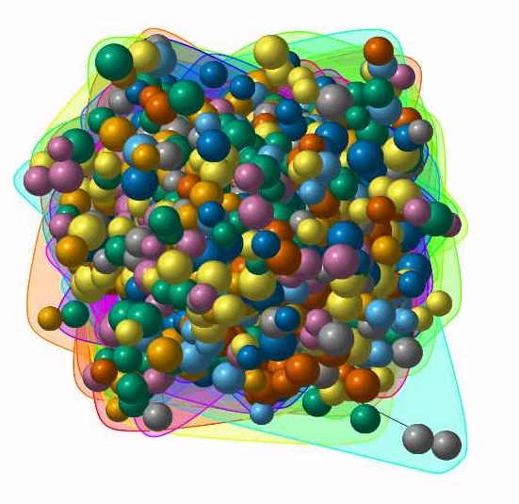
Protein Regulatory Netowork: SCZ
'Key proteins' defined by:​
vertex degree > 5​
hub score > 0.8​
authority scores > 0.8
KEGG enrichment on key proteins (top 10 pathways at p<0.05)
Prolactin, Adherens Junctions, & N-Glycan (C1) have strong associations with SCZ in literature
Cholesterol & Steroids (C2) also associated with Schizophrenia in literature
Cell-to-cell comms (C3) also strongly associated with Schizophrenia in literature
Also immune element to both C2 and C3 (stronger)
C1 | C2 | C3
PROLACTIN SIGNALING PATHWAY | CHOLESTEROL METABOLISM | CELL COMMUNICATION
ADHERENS JUNCTION | PROTEIN DIGESTION AND ABSORPTION HOMO SAPIENS HSA04974 | HSA01430 CELL COMMUNICATION
PROLACTIN SIGNALING PATHWAY HOMO SAPIENS HSA04917 | PROTEIN DIGESTION AND ABSORPTION | ASTHMA HOMO SAPIENS HSA05310
ADHERENS JUNCTION HOMO SAPIENS HSA04520 | CYTOKINE-CYTOKINE RECEPTOR INTERACTION | ASTHMA
HSA04520 ADHERENS JUNCTION | STEROID BIOSYNTHESIS | CYTOKINE-CYTOKINE RECEPTOR INTERACTION
OSTEOCLAST DIFFERENTIATION | STEROID BIOSYNTHESIS HOMO SAPIENS HSA00100 | CYTOKINE CYTOKINE RECEPTOR INTERACTION
OSTEOCLAST DIFFERENTIATION HOMO SAPIENS HSA04380 |  | HSA04060 CYTOKINE CYTOKINE RECEPTOR INTERACTION
N GLYCAN DEGRADATION |  | CYTOKINE-CYTOKINE RECEPTOR INTERACTION HOMO SAPIENS HSA04060
HSA00511 N GLYCAN DEGRADATION |  | HSA04512 ECM RECEPTOR INTERACTION
OTHER GLYCAN DEGRADATION HOMO SAPIENS HSA00511 |  | ECM RECEPTOR INTERACTION
Results are in line with earlier GO and KEGG enrichments, but add more granularity

Slide 35
Protein Regulatory Netowork: SCZ
'Key proteins' defined by:​
vertex degree > 5​
hub score > 0.8​
authority scores > 0.8
For reference, the key proteins per subtype
C1 | C2 | C3
ACTN4; ADAMTS1; ADGRB3; ADIPOQ; AIF1L; CALY; CCN3; CD6; CES2; CRTAM; DNAJA4; DPEP2; EDEM2; ESR1; FAM172A; FRZB; FUCA1; GAS6; IGSF3; IGSF9; KIR2DL2; KLF4; LILRA3; LRP1; MANSC4; NPHS2; PLB1; PRL; RANBP2; SAG; SCN2B; TGFBR1; TNXB; TP53INP1; TSPAN15 | ABCA2; ANGPTL3; ASPSCR1; BHLHE40; BOLA2_BOLA2B; C1QTNF9; CADPS; CCL14; CELSR2; CLC; COL2A1; CPA2; CREBZF; CRISP2; CYP24A1; DUSP3; ENPP7; FGF7; HSD17B3; IDO1; IL1RL1; IL5RA; ILKAP; LRP1; LRTM2; LTO1; OTUD7B; PBK; POSTN; PTPN1; SAP18; SCRIB; SERPINA1; SPRR1B; STX1B; TLR1; TMPRSS5; VIPR1; VMO1 | ADAMTSL2; ALCAM; AP2B1; CCL11; CCL25; CDH17; CFP; COL3A1; CRELD1; DPP6; DSG4; EPB41L5; GHRL; H2AP; ICAM2; IFNAR1; IL36A; KLK6; KRT8; LAMB1; LSP1; MLN; MSMB; NUDT5; OMG; PPT1; RNASE3; RNF41; SERPINA11; SEZ6L; THOP1

Slide 36
Gene-Set Variation Analysis (GSVA)

Slide 37
Gene-Set Variation Analysis (GSVA)
GSVA 'deconvolutes' a protein-by-sample matrix into pathway-by-sample
Utilizes any pathway / signature, custom or otherwise
Here, utilized manually-curated Hallmark signatures (https://www.ncbi.nlm.nih.gov/pmc/articles/PMC4707969/)
Permits that one looks at data at pathway --not gene/protein-- level
Differential Expression Analysis (standard) vs Differential Pathway Analysis (GSVA)

Slide 38
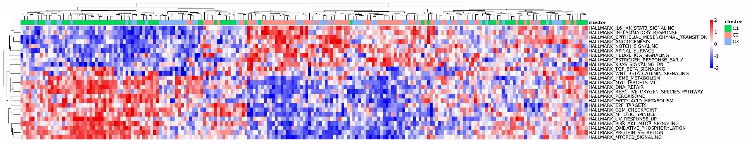
Protein Regulatory Network: BP
Clustering on stat. significant GSVA pathways across pairwise comparisons:
C1 vs C2
C1 vs C3
C2 vs C3
Results indicate:
C2 (primarily) + C3 remain the BP subtypes with immune involvement
C1 is a non-immune subtype

Slide 39
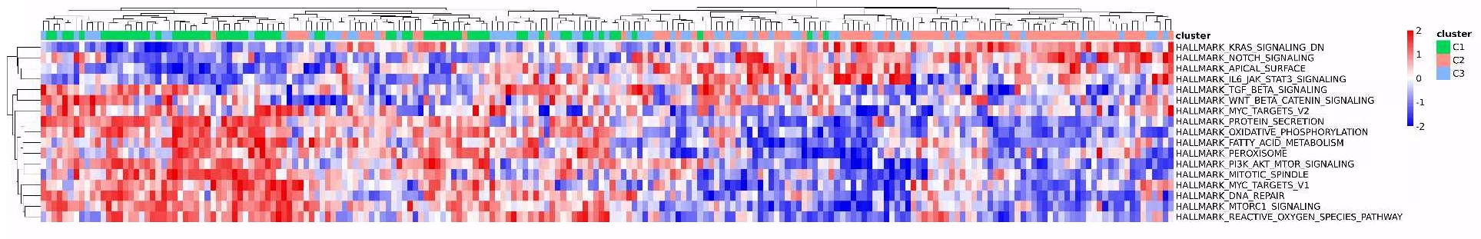
Protein Regulatory Network: SCZ
Clustering on stat. significant GSVA pathways across pairwise comparisons:
C1 vs C2
C1 vs C3
C2 vs C3
Results indicate:
C2 + C3 remain the SCZ subtypes with immune involvement
C1 is a non-immune subtype
Results are in line with earlier GO and KEGG enrichments, but add more granularity

